Slide 1
Analysis of Variance

Slide 2
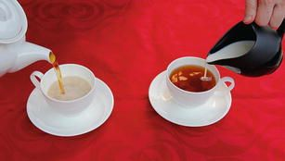
Experimental Designs
Tea Tasting Lady
Muriel Bristol
Started with Sir Ronald Fisher with Agrl. Expts.
Renewed interest in the 80’s due to Quality Issues
Services and Marketing professionals showed interest in the 90’s
Originally used for “Split Run” testing (one variable at a time. Referred to as A/B splits
Multifactor testing is a recent phenomenon
Wide usage in product testing in retail, e-commerce, supermarkets etc.
Analysis of Variance (ANOVA) is an integral part

Slide 3
ANOVA
H0: μ₁ = μ₂ = μ₃ = …..= μ_{k}
H1: At least one μ is different
Assumptions:
For each population, the response variable is normally distributed -- What is the response variable?
The variance of the response variable (σ²) is the same for all populations
The observations are independent of each other

Slide 4
Three Samples – Three Populations
μ₁=μ₂=μ₃
μ₁
μ₂
μ₃

Slide 5






Three Samples – Three Populations
$${\overline{X}}_{2}$$
$${\overline{X}}_{2}$$
$${\overline{X}}_{1}$$
$${\overline{X}}_{1}$$
$${\overline{X}}_{3}$$
$${\overline{X}}_{3}$$

Slide 6
Composite Population
Let us combine all the three samples, as if they come from a composite population!
This itself is the composite population!

Slide 7
Create “Composite Population”
Composite population

Slide 8
Variance of the Composite Population
The variance of the composite population can be decomposed into two components
1. Variance attributable to σ²
2. Difference between the means
If null hypothesis is true, item 2 above is close to zero! Any variation is only because of the sampling error
If the null hypothesis is NOT true, item 2 is large enough (as large as the differences between µ’s.

Slide 9
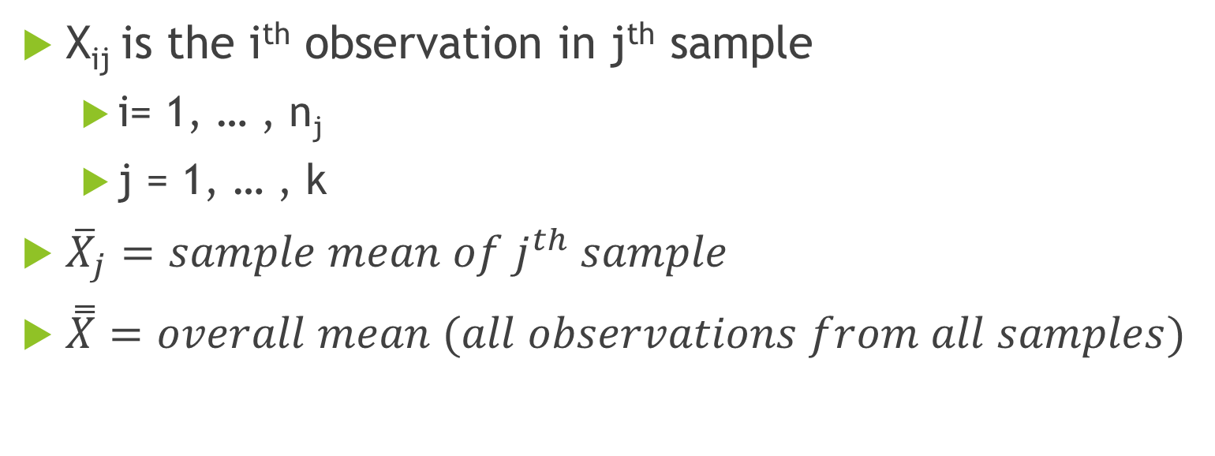
Notations:
X_{ij} is the i^{th} observation in j^{th} sample
i= 1, … , n_{j}
j = 1, … , k
${\overline{X}}_{j}=sample mean of j^{th} sample$
$\overset{̿}{X}=overall mean (all observations from all samples)$

Slide 10
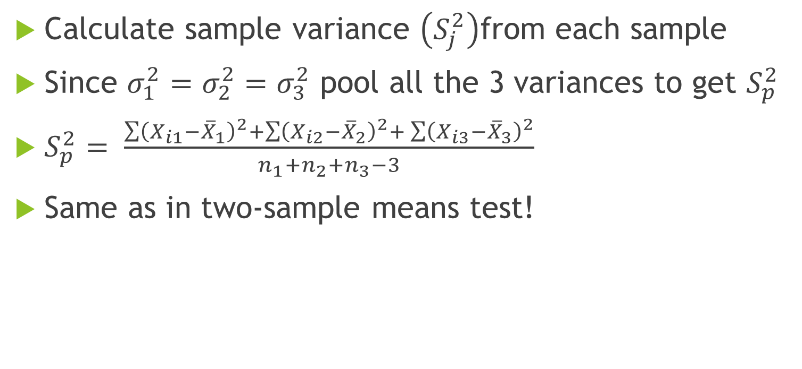
Variation Attributable to σ²
Calculate sample variance $\left(S_{j}^{2}\right)$from each sample
Since $σ_{1}^{2}=σ_{2}^{2}=σ_{3}^{2}$ pool all the 3 variances to get $S_{p}^{2}$
$S_{p}^{2}= \frac{\sum{{\left(X_{i1}−{\overline{X}}_{1}\right)}^{2}+\sum{{\left(X_{i2}−{\overline{X}}_{2}\right)}^{2}+}\sum{{\left(X_{i3}−{\overline{X}}_{3}\right)}^{2}}}}{n_{1}+n_{2}+n_{3}−3}$
Same as in two-sample means test!

Slide 11
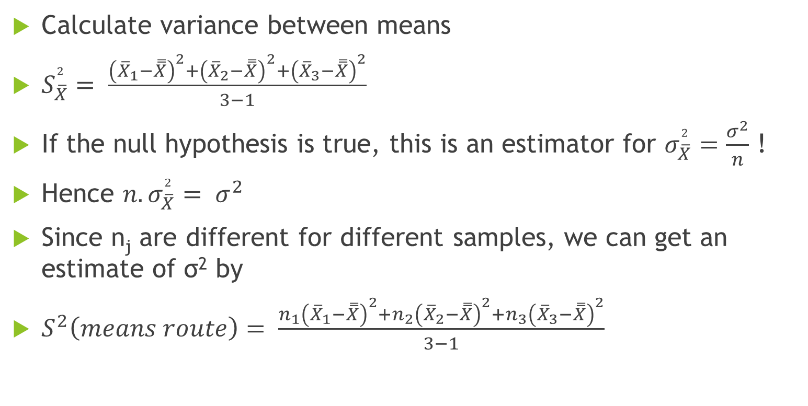
Variance attributable to difference between means
Calculate variance between means
$S_{\overline{X}}^{2}= \frac{{\left({\overline{X}}_{1}−\overset{̿}{X}\right)}^{2}+{\left({\overline{X}}_{2}−\overset{̿}{X}\right)}^{2}+{\left({\overline{X}}_{3}−\overset{̿}{X}\right)}^{2}}{3−1}$
If the null hypothesis is true, this is an estimator for $σ_{\overline{X}}^{2}=\frac{σ^{2}}{n}$ !
Hence $n.σ_{\overline{X}}^{2}= σ^{2}$
Since n_{j} are different for different samples, we can get an estimate of σ² by
$S^{2}\left(means route\right)= \frac{{n_{1}\left({\overline{X}}_{1}−\overset{̿}{X}\right)}^{2}+{n_{2}\left({\overline{X}}_{2}−\overset{̿}{X}\right)}^{2}+{n_{3}\left({\overline{X}}_{3}−\overset{̿}{X}\right)}^{2}}{3−1}$

Slide 12
Summary
We have estimated two different estimates for variance
One through S² route and the other through means route
If the null hypothesis is true, then both these estimate the same σ².
If the null hypothesis is NOT true, the second one (variance obtained from “means route” must be larger than the one obtained from S² route.
All we need to do is test for equality of variances (F test)
If F value is significant, null hypothesis is rejected.

Slide 13
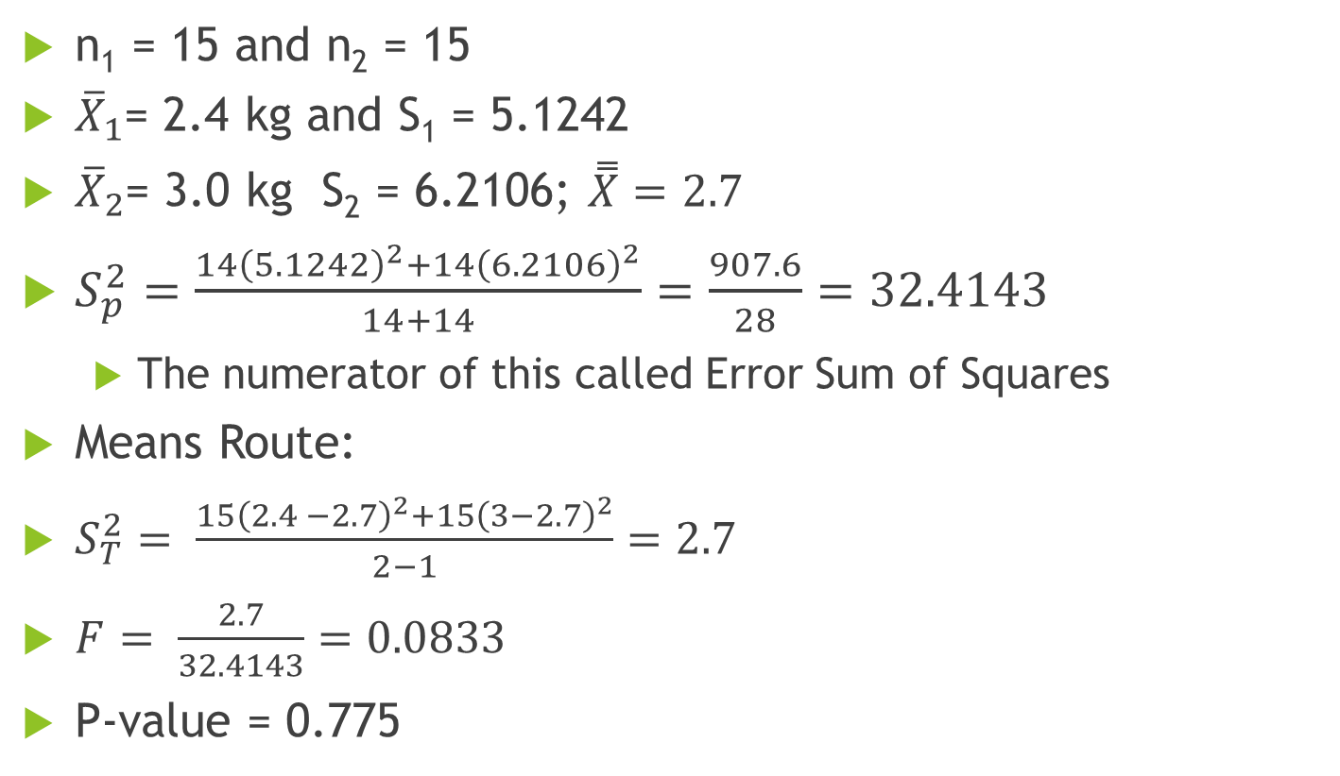
Chubby Chunky - 3
n₁ = 15 and n₂ = 15
${\overline{X}}_{1}$= 2.4 kg and S₁ = 5.1242
${\overline{X}}_{2}$= 3.0 kg S₂ = 6.2106; $\overset{̿}{X}=2.7$
$S_{p}^{2}=\frac{14{\left(5.1242\right)}^{2}+14{\left(6.2106\right)}^{2}}{14+14}=\frac{907.6}{28}=32.4143$
The numerator of this called Error Sum of Squares
Means Route:
$S_{T}^{2}= \frac{15{\left(2.4 −2.7\right)}^{2}+15{\left(3−2.7\right)}^{2}}{2−1}=2.7$
$F= \frac{2.7}{32.4143}=0.0833$
P-value = 0.775

Slide 14
Revisit Chubby Chunky – 2

Slide 15
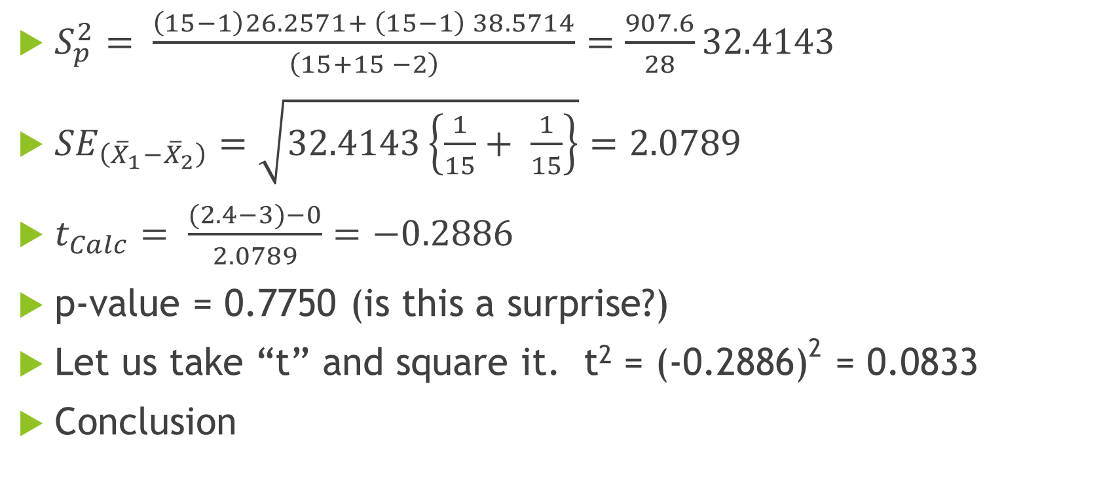
Hypothesis Test
$S_{p}^{2}= \frac{\left(15−1\right)26.2571+ \left(15−1\right) 38.5714}{\left(15+15 −2\right)}=\frac{907.6}{28}32.4143$
${SE}_{\left({\overline{X}}_{1}−{\overline{X}}_{2}\right)}=\sqrt{32.4143\left\{\frac{1}{15}+ \frac{1}{15}\right\}}=2.0789$
$t_{Calc}= \frac{(2.4−3)−0}{2.0789}=−0.2886$
p-value = 0.7750 (is this a surprise?)
Let us take “t” and square it. t² = (-0.2886)² = 0.0833
Conclusion

Slide 16
Notations:
X_{ij} is the i^{th} observation in j^{th} sample
i= 1, … , n_{j}
j = 1, … , k
${\overline{X}}_{j}=sample mean of j^{th} sample$
$\overset{̿}{X}=overall mean (all observations from all samples)$

Slide 17
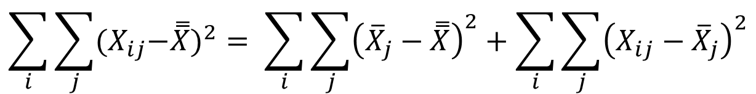
ANOVA Table and Calculations
$$\sum_{i}{\sum_{j}{{{(X}_{ij}−\overset{̿}{X})}^{2}= \sum_{i}{\sum_{j}{{\left({\overline{X}}_{j}−\overset{̿}{X}\right)}^{2}+\sum_{i}{\sum_{j}{{\left(X_{ij}−{\overline{X}}_{j}\right)}^{2}}}}}}}$$
Total Sum of Squares
Between Sum of Squares
Within Sum of Squares

Slide 18
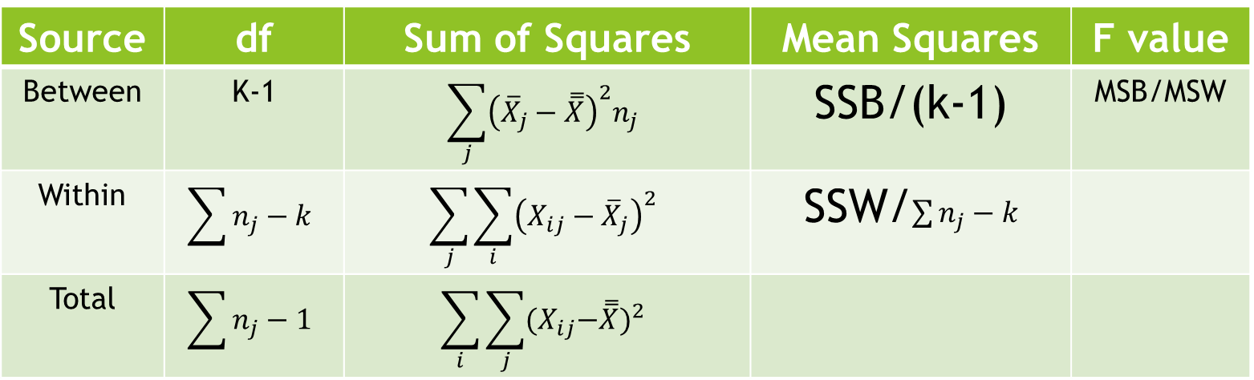
ANOVA Table
Source | df | Sum of Squares | Mean Squares | F value
Between | K-1 | $$\sum_{j}{{\left({\overline{X}}_{j}−\overset{̿}{X}\right)}^{2}n_{j}}$$ | SSB/(k-1) | MSB/MSW
Within | $$\sum{n_{j}−k}$$ | $$\sum_{j}{\sum_{i}{{\left(X_{ij}−{\overline{X}}_{j}\right)}^{2}}}$$ | SSW/$\sum{n_{j}−k}$
Total | $$\sum{n_{j}−1}$$ | $$\sum_{i}{\sum_{j}{{{(X}_{ij}−\overset{̿}{X})}^{2}}}$$

Slide 19
Chubby Chunky – ANOVA TABLE
Source of Variation | SS | df | MS | F | P-value | F crit
Between Groups | 2.7 | 1 | 2.7 | 0.0833 | 0.775 | 4.195972
Within Groups | 907.6 | 28 | 32.4143
Total | 910.3 | 29

Slide 20
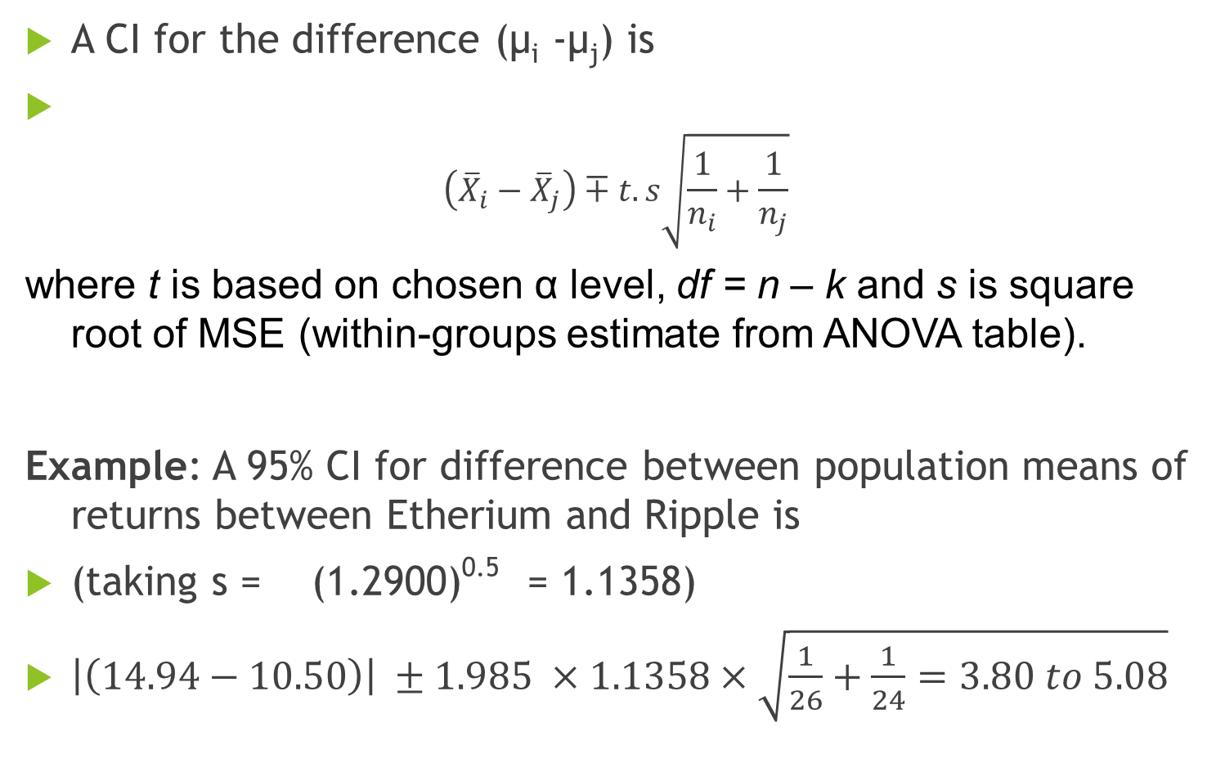
Comparisons of Pairs of Means
A CI for the difference (µ_{i} -µ_{j}) is
$$\left({\overline{X}}_{i}−{\overline{X}}_{j}\right)∓t.s\sqrt{\frac{1}{n_{i}}+\frac{1}{n_{j}}}$$
where t is based on chosen α level, df = n – k and s is square root of MSE (within-groups estimate from ANOVA table).
Example: A 95% CI for difference between population means of returns between Etherium and Ripple is
(taking s = (1.2900)^{0.5} = 1.1358)
$\left|\left(14.94−10.50\right)\right| ±1.985 ×1.1358×\sqrt{\frac{1}{26}+\frac{1}{24}=3.80 to 5.08}$

Slide 21
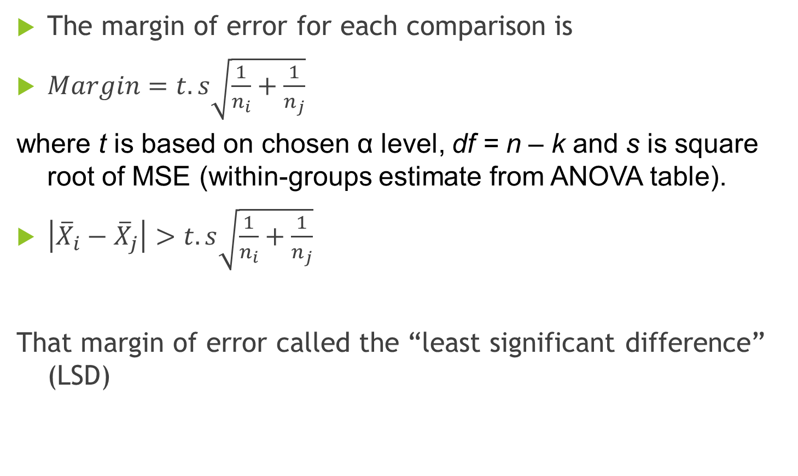
Comparing pairs of means
The margin of error for each comparison is
$Margin=t.s\sqrt{\frac{1}{n_{i}}+\frac{1}{n_{j}}}$
where t is based on chosen α level, df = n – k and s is square root of MSE (within-groups estimate from ANOVA table).
$\left|{\overline{X}}_{i}−{\overline{X}}_{j}\right|>t.s\sqrt{\frac{1}{n_{i}}+\frac{1}{n_{j}}}$
That margin of error called the “least significant difference” (LSD)

Slide 22
Multiple Comparisons
Multiple Comparisons
Dependent Variable: | Return
LSD
(I) Currency |  | Mean Difference (I-J) | Std. Error | Sig. | 95% Confidence Interval
 |  |  |  |  | Lower Bound | Upper Bound
Ripple | Dash | 2.48295* | .31815 | .000 | 1.8514 | 3.1145
 | Etherium | -4.44135* | .32151 | .000 | -5.0795 | -3.8032
 | LiteCoin | -6.69825* | .31815 | .000 | -7.3298 | -6.0667
Dash | Ripple | -2.48295* | .31815 | .000 | -3.1145 | -1.8514
 | Etherium | -6.92430* | .32458 | .000 | -7.5686 | -6.2800
 | LiteCoin | -9.18120* | .32125 | .000 | -9.8189 | -8.5435
Etherium | Ripple | 4.44135* | .32151 | .000 | 3.8032 | 5.0795
 | Dash | 6.92430* | .32458 | .000 | 6.2800 | 7.5686
 | LiteCoin | -2.25690* | .32458 | .000 | -2.9012 | -1.6126
LiteCoin | Ripple | 6.69825* | .31815 | .000 | 6.0667 | 7.3298
 | Dash | 9.18120* | .32125 | .000 | 8.5435 | 9.8189
 | Etherium | 2.25690* | .32458 | .000 | 1.6126 | 2.9012
*. The mean difference is significant at the 0.05 level.

Slide 23
Questions?
Clarifications?

